Slide 1

Microprocessors and Assembly Language Fall 2019
Hamed Farbeh
farbeh@aut.ac.ir
Department of Computer Engineering
Amirkabir University of Technology
Lecture 21

Slide 2
Copyright Notice
Parts (text & figures) of this lecture are adopted from:
Prabal Dutta, “EECS 373 Design of Microprocessor-Based Systems,” University of Michigan
Atmel | SMART ARM-based MCU DATASHEET, SAM3X / SAM3A Series, Atmel-11057C-ATARM-SAM3X-SAM3A-Datasheet_23-Mar-15
Microprocessors and Assembly Language, Fall 2019, AUT, Tehran, Iran

Slide 3
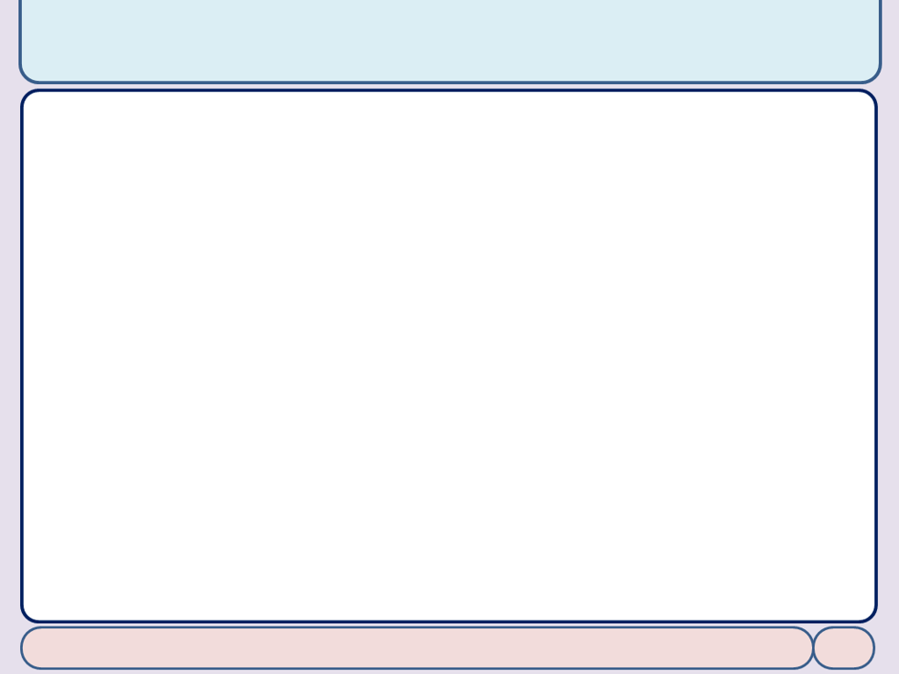
Sampling, ADCs, and DACs
Microprocessors and Assembly Language, Fall 2019, AUT, Tehran, Iran

Slide 4
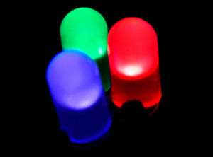
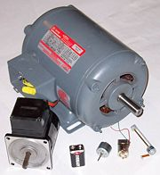
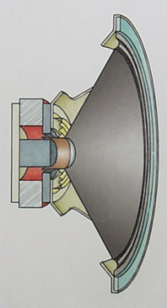
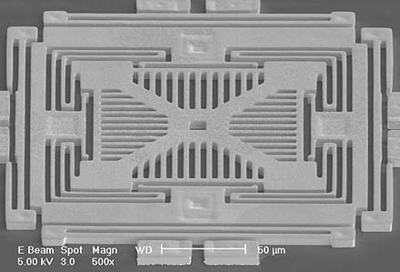
We live in an analog world
Everything in the physical world is an analog signal
Sound, light, temperature, pressure
Need to convert into electrical signals
Transducers: converts one type of energy to another
Electro-mechanical, Photonic, Electrical, …
Examples
Microphone/speaker
Thermocouples
Accelerometers
EECS 373 Design of Microprocessor-Based Systems
Microprocessors and Assembly Language, Fall 2019, AUT, Tehran, Iran

Slide 5
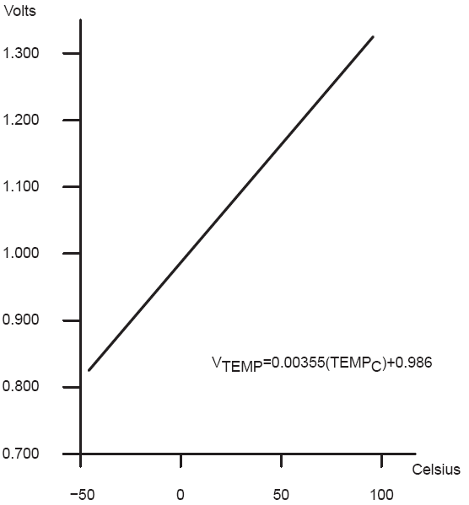
Transducers
Transducers convert one form of energy into another
Allow us to convert physical phenomena to a voltage potential in a well-defined way
A transducer is a device that converts one type of energy to another. The conversion can be to/from
electrical, electro-mechanical, electromagnetic, photonic, photovoltaic, or any other form of energy.
While the term transducer commonly implies use as a sensor/detector, any device which converts energy can be considered a transducer. [Wikipedia]
EECS 373 Design of Microprocessor-Based Systems
Microprocessors and Assembly Language, Fall 2019, AUT, Tehran, Iran

Slide 6
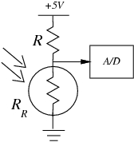
An Example: Photocell
Convert light to voltage with a CdS Photocell
V_{signal} = (+5V) R_{R}/(R + R_{R})
Choose R=R_{R} at median of intended range
Cadmium Sulfide (CdS)
t_{RC} = (R+R_{R})*C_{l}
Typically R~50-200kΩ
C~20pF
So, t_{RC}~20-80uS
f_{RC} ~ 10-50kHz
EECS 373 Design of Microprocessor-Based Systems
Microprocessors and Assembly Language, Fall 2019, AUT, Tehran, Iran

Slide 7
Many other common sensors
Force
Sound
Microphones
Position
Gyros
Acceleration
Field
…
EECS 373 Design of Microprocessor-Based Systems
Microprocessors and Assembly Language, Fall 2019, AUT, Tehran, Iran

Slide 8
Going from Analog to Digital
What we want
How we have to get there
Physical
Phenomena
Engineering Units
Physical
Phenomena
Voltage or
Current
ADC Counts
Engineering Units
Sensor
ADC
Software
EECS 373 Design of Microprocessor-Based Systems
Microprocessors and Assembly Language, Fall 2019, AUT, Tehran, Iran

Slide 9
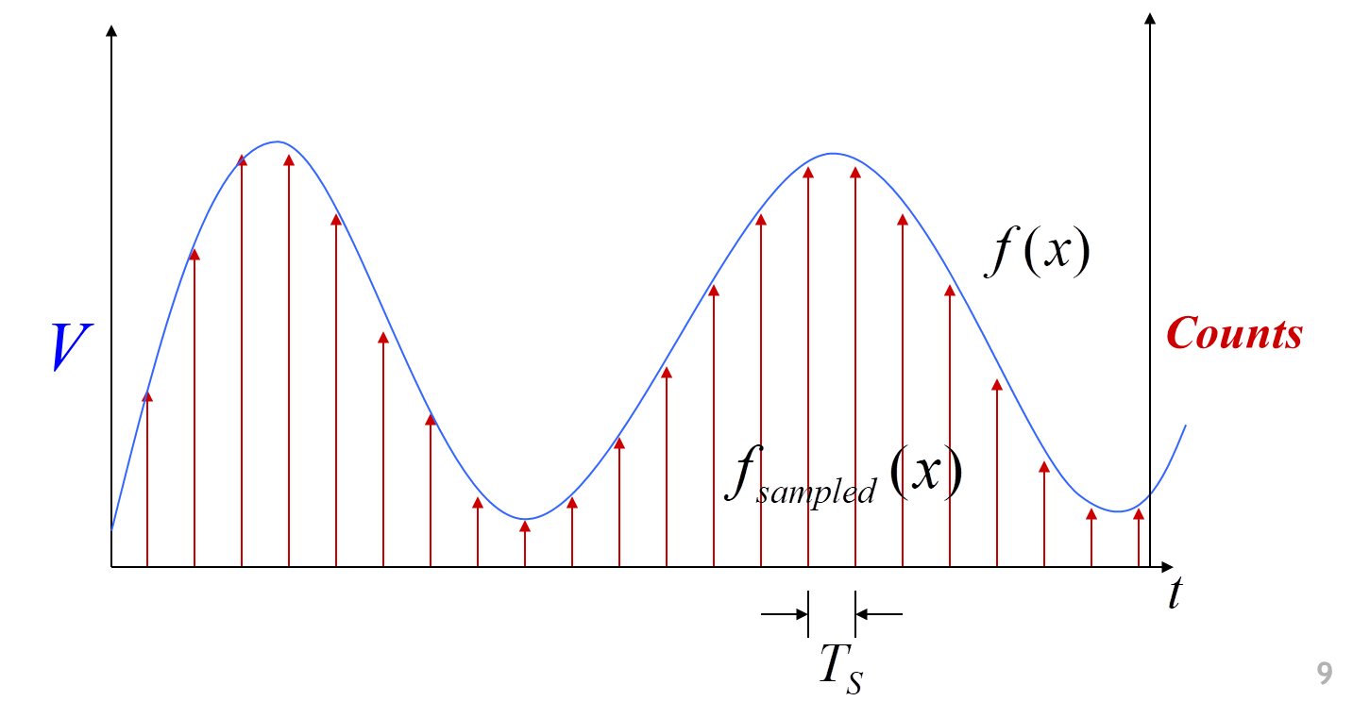
Representing an analog signal digitally
How do we represent an analog signal?
As a time series of discrete values
On MCU: read the ADC data register periodically
EECS 373 Design of Microprocessor-Based Systems
Microprocessors and Assembly Language, Fall 2019, AUT, Tehran, Iran

Slide 10
Choosing the horizontal range
What do the sample values represent?
Some fraction within the range of values
What range to use?
Range Too Small
Range Too Big
Ideal Range
EECS 373 Design of Microprocessor-Based Systems
Microprocessors and Assembly Language, Fall 2019, AUT, Tehran, Iran

Slide 11
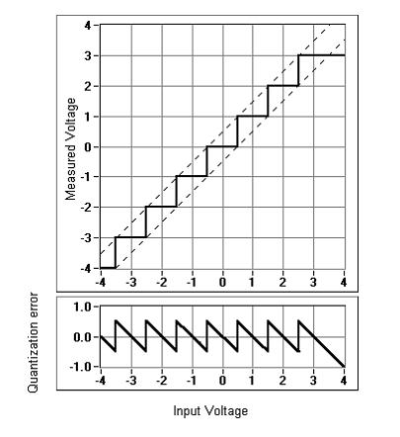
Choosing the horizontal granularity
Resolution
Number of discrete values that represent a range of analog values
12-bit ADC
4096 values
Range / 4096 = Step
Larger range → less information
Quantization Error
How far off discrete value is
from actual
½ LSB → Range / 8192
Larger range → larger error
EECS 373 Design of Microprocessor-Based Systems
Microprocessors and Assembly Language, Fall 2019, AUT, Tehran, Iran

Slide 12
Choosing the sample rate
What sample rate do we need?
Too little: we can’t reconstruct the signal we care about
Too much: waste computation, energy, resources
EECS 373 Design of Microprocessor-Based Systems
Microprocessors and Assembly Language, Fall 2019, AUT, Tehran, Iran

Slide 13
Conversion: ADC
Converting between voltages, ADC counts, and engineering units
Converting: ADC counts → Voltage
Converting: Voltage ⬄ Engineering Units
EECS 373 Design of Microprocessor-Based Systems
Microprocessors and Assembly Language, Fall 2019, AUT, Tehran, Iran

Slide 14
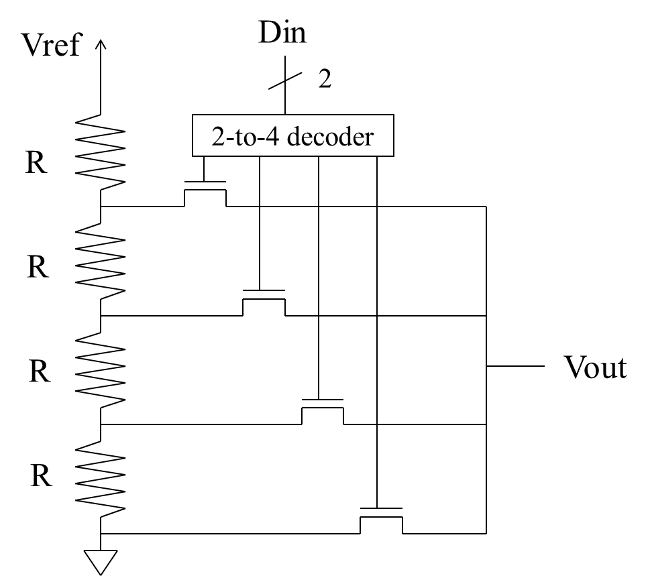
Conversion: DAC
DAC 1: Voltage Divider
EECS 373 Design of Microprocessor-Based Systems
Microprocessors and Assembly Language, Fall 2019, AUT, Tehran, Iran

Slide 15
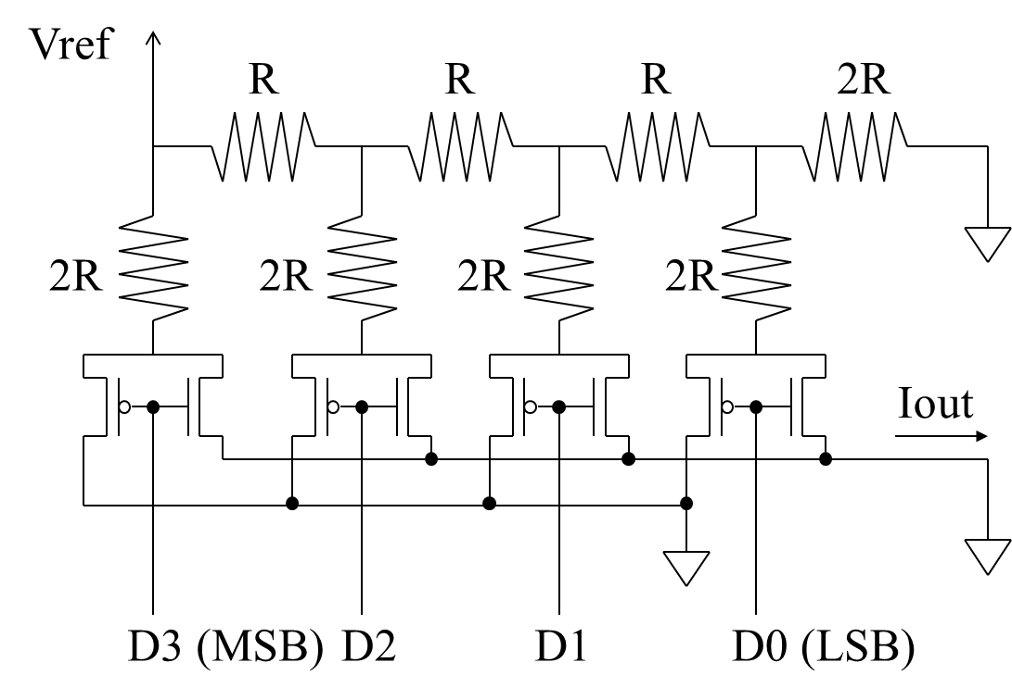
Conversion: DAC
DAC 2: R/2R Ladder
EECS 373 Design of Microprocessor-Based Systems
Microprocessors and Assembly Language, Fall 2019, AUT, Tehran, Iran

Slide 16
ADC in SAM3X
A 16-to-1 analog multiplexer
Making possible the analog-to-digital conversions of 16 analog lines
The conversions extend from 0V to ADVREF
supports an 10-bit or 12-bit resolution mode
conversion results are reported in a common register for all channels
as well as in a channel-dedicated register
1 MHz Conversion Rate
Individual Enable and Disable of Each Channel
Atmel | SMART ARM-based MCU DATASHEET, SAM3X / SAM3A Series, Atmel-11057C-ATARM-SAM3X-SAM3A-Datasheet_23-Mar-15
Microprocessors and Assembly Language, Fall 2019, AUT, Tehran, Iran

Slide 17
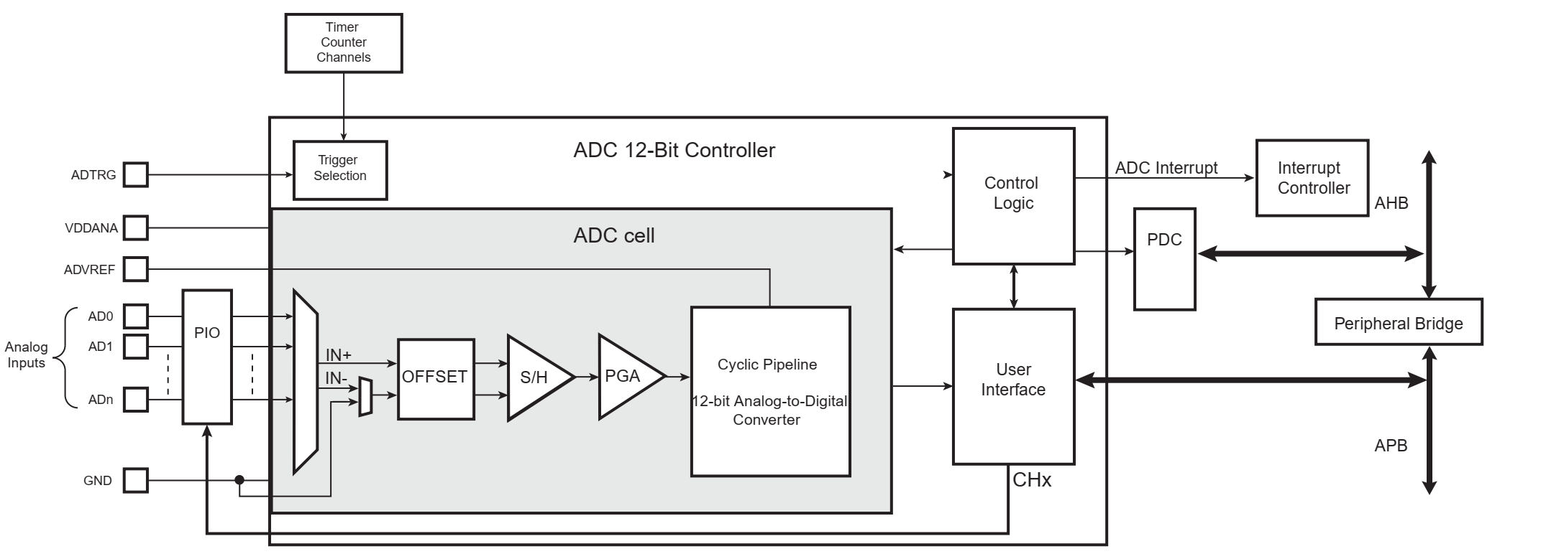
ADC in SAM3X
Analog-to-Digital Converter Block Diagram
The temperature sensor is connected to Channel 15 of the ADC
Atmel | SMART ARM-based MCU DATASHEET, SAM3X / SAM3A Series, Atmel-11057C-ATARM-SAM3X-SAM3A-Datasheet_23-Mar-15
Microprocessors and Assembly Language, Fall 2019, AUT, Tehran, Iran

Slide 18
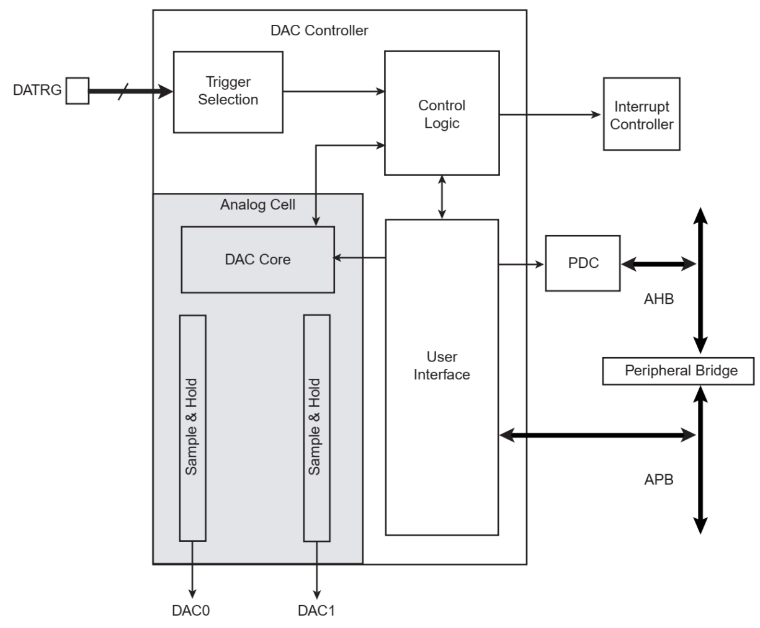
DAC in SAM3X
Digital-to-Analog Converter Controller (DACC)
Atmel | SMART ARM-based MCU DATASHEET, SAM3X / SAM3A Series, Atmel-11057C-ATARM-SAM3X-SAM3A-Datasheet_23-Mar-15
Microprocessors and Assembly Language, Fall 2019, AUT, Tehran, Iran

Slide 19
The End!
Microprocessors and Assembly Language, Fall 2019, AUT, Tehran, Iran

